Slide 1
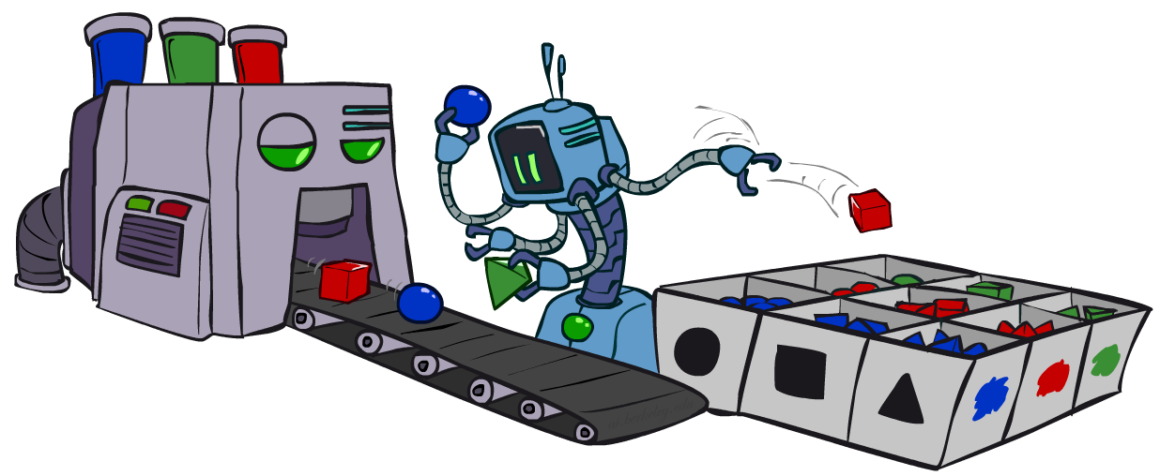
Artificial Intelligence
Bayes’ Nets: Sampling
[These slides were created by Dan Klein and Pieter Abbeel for CS188 Intro to AI at UC Berkeley. All CS188 materials are available at http://ai.berkeley.edu.]
Notes:
Please retain proper attribution, including the reference to ai.berkeley.edu. Thanks!

Slide 2
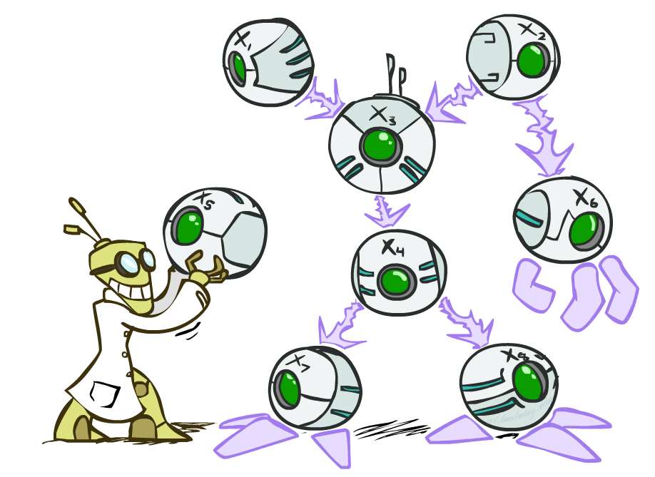

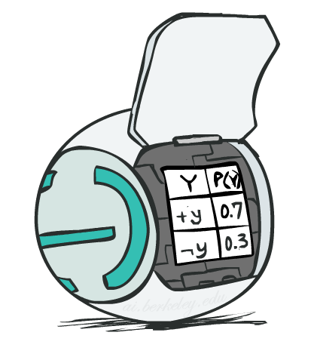
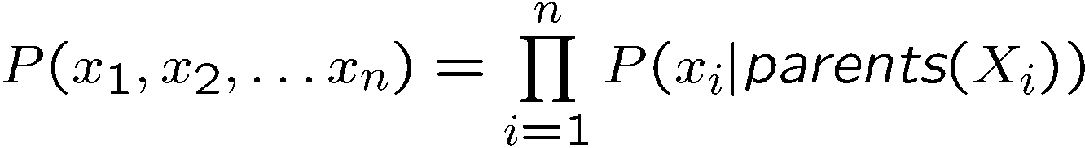
Bayes’ Net Representation
A directed, acyclic graph, one node per random variable
A conditional probability table (CPT) for each node
A collection of distributions over X, one for each combination of parents’ values
Bayes’ nets implicitly encode joint distributions
As a product of local conditional distributions
To see what probability a BN gives to a full assignment, multiply all the relevant conditionals together:

Slide 3
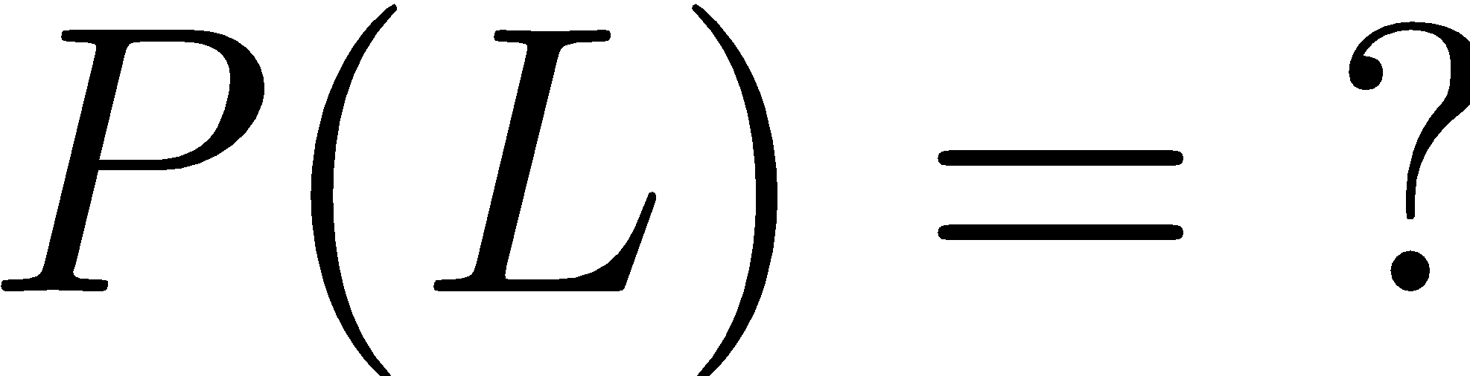
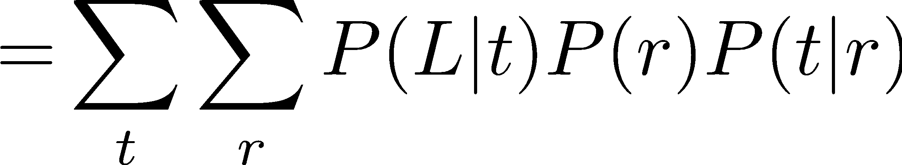
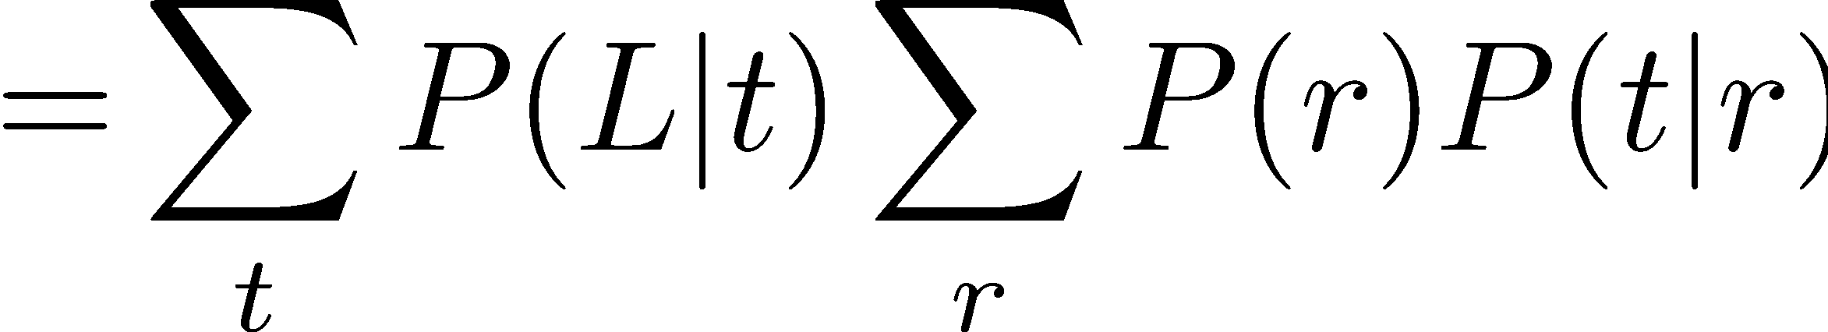
Recap: Bayesian Inference (Exact)
R
Inference by Enumeration
Variable Elimination
T
L
Join on r
Join on r
Join on t
Eliminate r
Eliminate r
Join on t
Eliminate t
Eliminate t

Slide 4

Approximate Inference: Sampling

Slide 5

Sampling
Sampling is a lot like repeated simulation
Predicting the weather, basketball games, …
Basic idea
Draw N samples from a sampling distribution S
Compute an approximate posterior probability
Show this converges to the true probability P
Why sample?
Learning: get samples from a distribution you don’t know
Inference: getting a sample is faster than computing the right answer (e.g. with variable elimination)

Slide 6
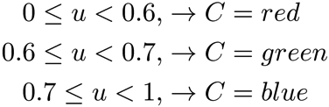

Sampling
Sampling from given distribution
Step 1: Get sample u from uniform distribution over [0, 1)
E.g. random() in python
Step 2: Convert this sample u into an outcome for the given distribution by having each target outcome associated with a sub-interval of [0,1) with sub-interval size equal to probability of the outcome
Example
If random() returns u = 0.83, then our sample is C = blue
E.g, after sampling 8 times:
C | P(C)
red | 0.6
green | 0.1
blue | 0.3
Notes:
redo

Slide 7
Sampling in Bayes’ Nets
Prior Sampling
Rejection Sampling
Likelihood Weighting
Gibbs Sampling

Slide 8
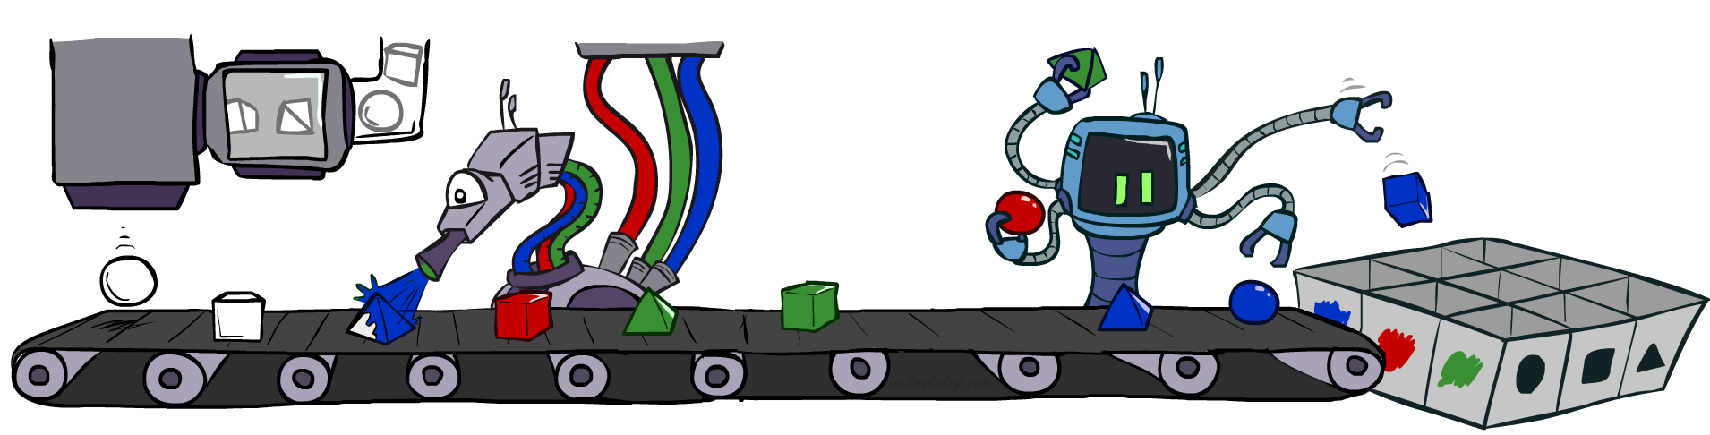
Prior Sampling

Slide 9




Prior Sampling
+c | 0.5
-c | 0.5
Cloudy
+c | +s | 0.1
 | -s | 0.9
-c | +s | 0.5
 | -s | 0.5
Cloudy
+c | +r | 0.8
 | -r | 0.2
-c | +r | 0.2
 | -r | 0.8
Sprinkler
Sprinkler
Rain
Rain
WetGrass
Samples:
+s | +r | +w | 0.99
 |  | -w | 0.01
 | -r | +w | 0.90
 |  | -w | 0.10
-s | +r | +w | 0.90
 |  | -w | 0.10
 | -r | +w | 0.01
 |  | -w | 0.99
WetGrass
+c, -s, +r, +w
-c, +s, -r, +w
…

Slide 10
Prior Sampling
For i = 1, 2, …, n in topological order
Sample x_{i} from P(X_{i} | Parents(X_{i}))
Return (x₁, x₂, …, x_{n})
Notes:
Topo sort it then iterate through

Slide 11
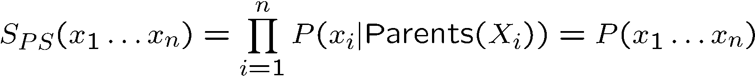

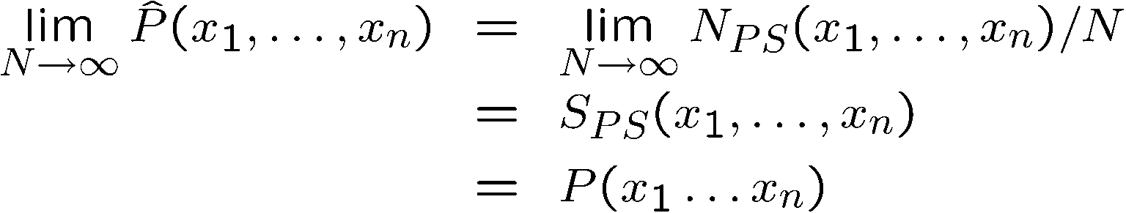
Prior Sampling
This process generates samples with probability:
…i.e. the BN’s joint probability
Let the number of samples of an event be
Then
I.e., the sampling procedure is consistent

Slide 12
Example
We’ll get a bunch of samples from the BN:
+c, -s, +r, +w
+c, +s, +r, +w
-c, +s, +r, -w
+c, -s, +r, +w
-c, -s, -r, +w
If we want to know P(W)
We have counts <+w:4, -w:1>
Normalize to get P(W) = <+w:0.8, -w:0.2>
This will get closer to the true distribution with more samples
Can estimate anything else, too
P(C | +w)? P(C | +r, +w)?
Can also use this to estimate expected value of f(X) - Monte Carlo Estimation
What about P(C | -r, -w)?
C
S
R
W

Slide 13
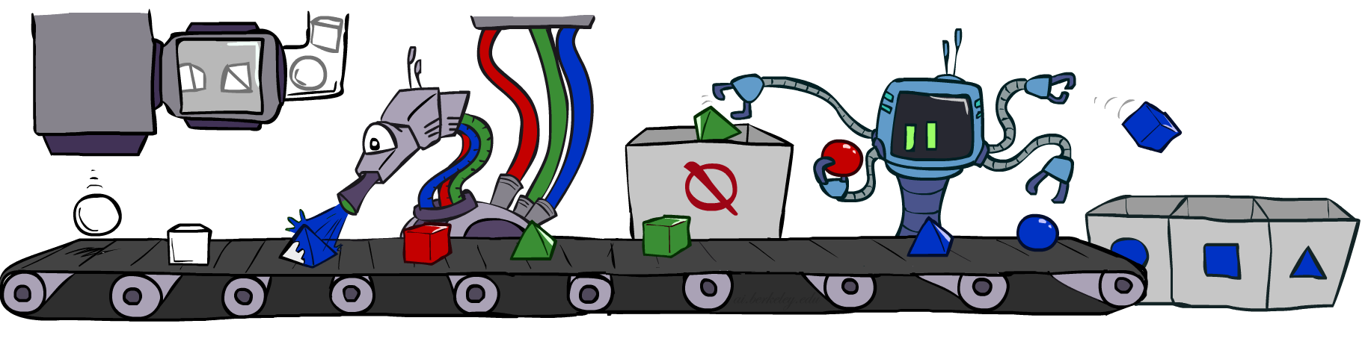
Rejection Sampling

Slide 14
Rejection Sampling
Let’s say we want P(C)
Just tally counts of C as we go
Let’s say we want P(C | +s)
Same thing: tally C outcomes, but ignore (reject) samples which don’t have S=+s
This is called rejection sampling
We can toss out samples early!
It is also consistent for conditional probabilities (i.e., correct in the limit)
C
S
R
W

Slide 15
Rejection Sampling
Input: evidence instantiation
For i = 1, 2, …, n in topological order
Sample x_{i} from P(X_{i} | Parents(X_{i}))
If x_{i} not consistent with evidence
Reject: return – no sample is generated in this cycle
Return (x₁, x₂, …, x_{n})

Slide 16
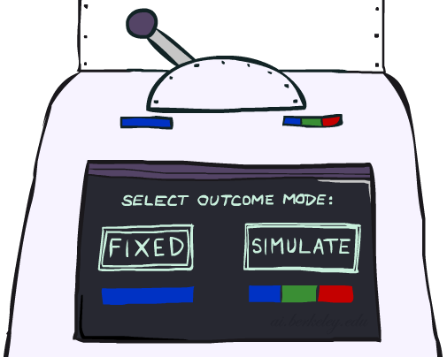
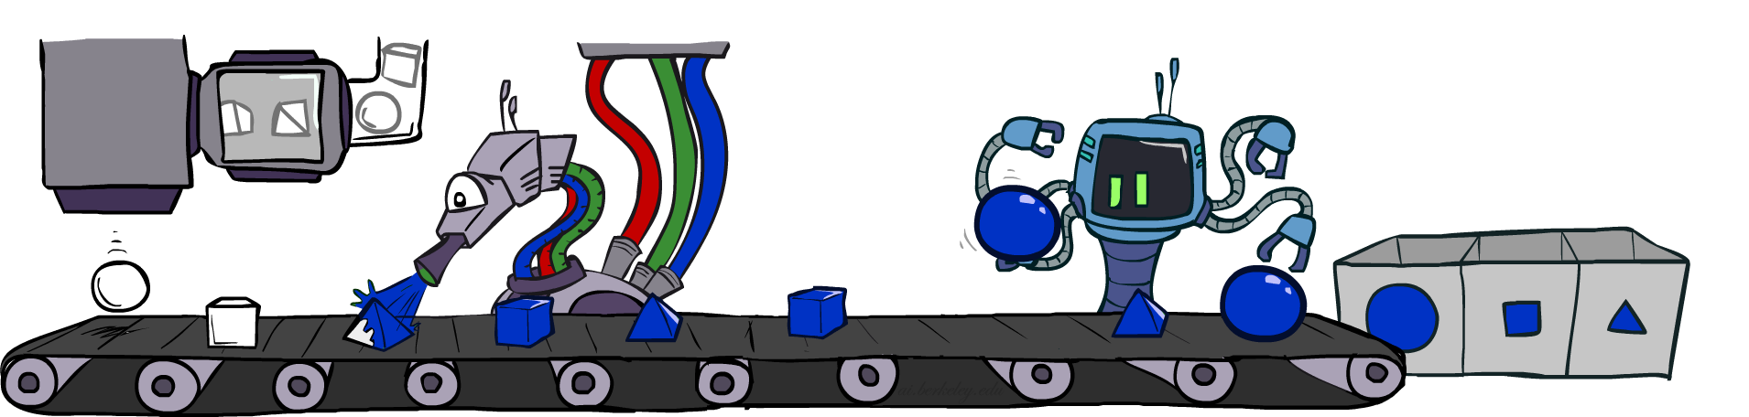
Likelihood Weighting

Slide 17
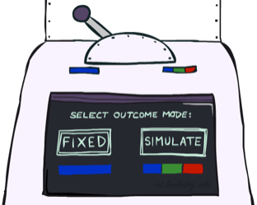


Likelihood Weighting
Problem with rejection sampling:
If evidence is unlikely, rejects lots of samples
Consider P( Shape | blue )
Idea: fix evidence variables and sample the rest
Problem: sample distribution not consistent!
Solution: weight by probability of evidence given parents
pyramid, green
pyramid, red
sphere, blue
cube, red
sphere, green
pyramid, blue
pyramid, blue
sphere, blue
cube, blue
sphere, blue
Shape
Color
Shape
Color

Slide 18
Likelihood Weighting
+c | 0.5
-c | 0.5
+c | +s | 0.1
 | -s | 0.9
-c | +s | 0.5
 | -s | 0.5
Cloudy
Cloudy
+c | +r | 0.8
 | -r | 0.2
-c | +r | 0.2
 | -r | 0.8
Sprinkler
Sprinkler
Rain
Rain
+s | +r | +w | 0.99
 |  | -w | 0.01
 | -r | +w | 0.90
 |  | -w | 0.10
-s | +r | +w | 0.90
 |  | -w | 0.10
 | -r | +w | 0.01
 |  | -w | 0.99
WetGrass
WetGrass
Samples:
+c, +s, +r, +w
w = 1.0 x 0.1 x 0.99
-c, +s, -r, +w
…
w = 1.0 x 0.5 x 0.90

Slide 19
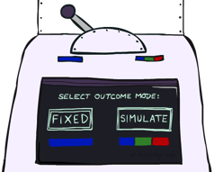
Likelihood Weighting
Input: evidence instantiation
w = 1.0
for i = 1, 2, …, n in topological order
if X_{i} is an evidence variable
X_{i} = observation x_{i} for X_{i}
Set w = w * P(x_{i} | Parents(X_{i}))
else
Sample x_{i} from P(X_{i} | Parents(X_{i}))
return (x₁, x₂, …, x_{n}), w

Slide 20
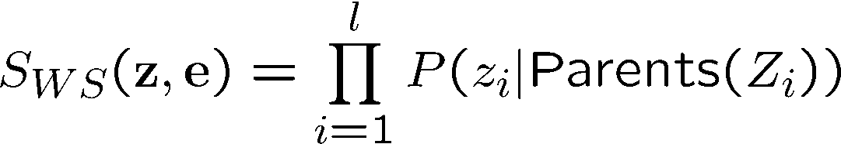
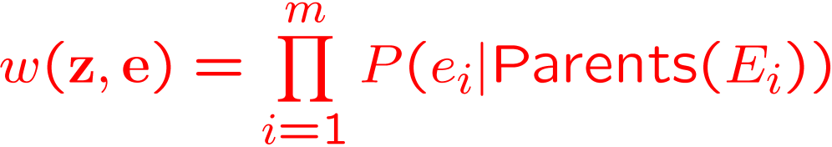
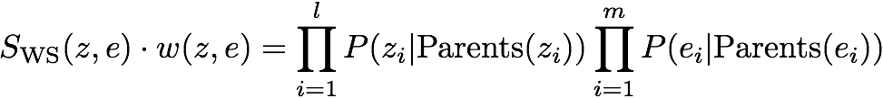

Likelihood Weighting
Sampling distribution if z sampled and e fixed evidence
Now, samples have weights
Together, weighted sampling distribution is consistent

Slide 21
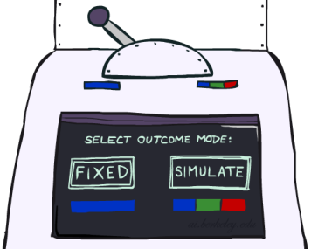
Likelihood Weighting
Likelihood weighting is helpful
We have taken evidence into account as we generate the sample
E.g. here, W’s value will get picked based on the evidence values of S, R
More of our samples will reflect the state of the world suggested by the evidence
Likelihood weighting doesn’t solve all our problems
Evidence influences the choice of downstream variables, but not upstream ones (C isn’t more likely to get a value matching the evidence)
We would like to consider evidence when we sample every variable (leads to Gibbs sampling)
C
S
R
W

Slide 22
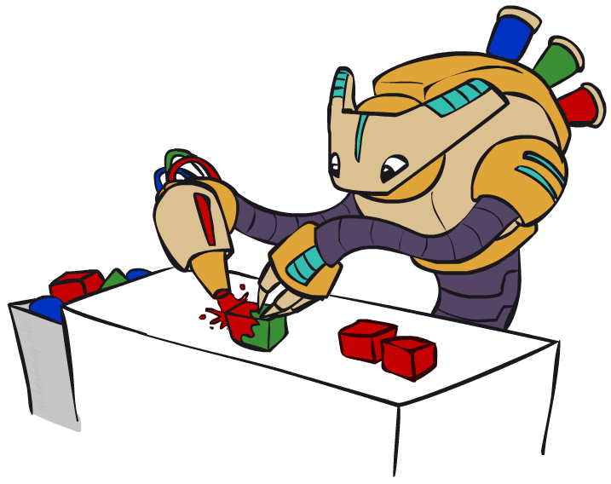
Gibbs Sampling

Slide 23
Gibbs Sampling Example: P( S | +r)
Step 1: Fix evidence
R = +r
Step 2: Initialize other variables
Randomly
C
C
S
+r
S
+r
W
W
Steps 3: Repeat
Choose a non-evidence variable X
Resample X from P( X | all other variables)*
C
C
C
C
C
C
S
+r
S
+r
S
+r
S
+r
S
+r
S
+r
W
W
W
W
W
W

Slide 24
Gibbs Sampling
Procedure: keep track of a full instantiation x₁, x₂, …, x_{n}. Start with an arbitrary instantiation consistent with the evidence. Sample one variable at a time, conditioned on all the rest, but keep evidence fixed. Keep repeating this for a long time.
Property: in the limit of repeating this infinitely many times the resulting samples come from the correct distribution (i.e. conditioned on evidence).
Rationale: both upstream and downstream variables condition on evidence.
In contrast: likelihood weighting only conditions on upstream evidence, and hence weights obtained in likelihood weighting can sometimes be very small. Sum of weights over all samples is indicative of how many “effective” samples were obtained, so we want high weight.
C
C
C
C
C
C
S
+r
S
+r
S
+r
S
+r
S
+r
S
+r
W
W
W
W
W
W

Slide 25
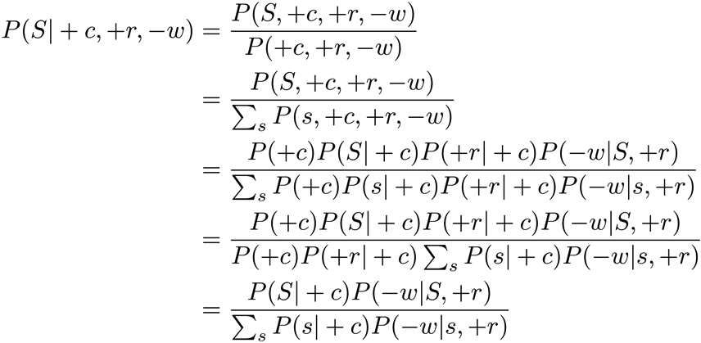
Resampling of One Variable
Sample from P(S | +c, +r, -w)
Many things cancel out – only CPTs with S remain!
More generally: only CPTs that have resampled variable need to be considered, and joined together
C
S
+r
W

Slide 26
More Details on Gibbs Sampling*
Gibbs sampling belongs to a family of sampling methods called Markov chain Monte Carlo (MCMC)
Specifically, it is a special case of a subset of MCMC methods called Metropolis-Hastings
You can read more about this here:
https://ermongroup.github.io/cs228-notes/inference/sampling/

Slide 27



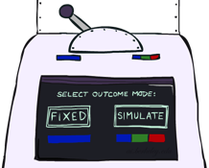

Bayes’ Net Sampling Summary
Prior Sampling P( Q )
Likelihood Weighting P( Q | e)
Rejection Sampling P( Q | e )
Gibbs Sampling P( Q | e )

